Slide 1
Not Getting Things Done
Toxic Productivity & ADHD

Slide 2


Slide 3
Disclaimer
I don't know what I'm talking about.
Notes:
I believe that we're all just making it up as we go along. no one has learned it all, we all have something to learn from others. that includes myself, this is only my experience. I'm also here to learn from you. I want to hear differing opinions and learn from what works for you

Slide 4
ADHD
Toxic Productivity
You
Notes:
We'll go over what ADHD is and what it looks like, toxic productivity, and end with some tools and tactics

Slide 5
Adult attention-deficit/hyperactivity disorder (ADHD) is a mental health disorder that includes a combination of persistent problems, such as difficulty paying attention, hyperactivity and impulsive behavior.
— Mayo Clinic
Notes:
not a super helpful description. More specifically, ADHD is a deficiency in the prefrontal cortex.

Slide 6
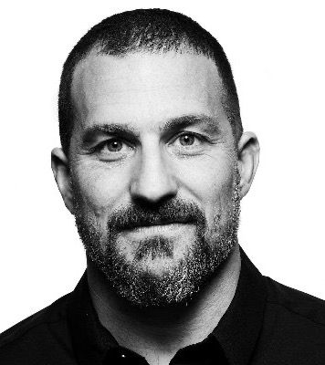
The prefrontal cortex is the orchestra conductor that says "shh" or "not right now".
— Andrew Huberman
Notes:
neuroscientist and professor at Stanford. it quiets and enhances different networks of the brain. so ADHD is a lack in ability to quiet the mind and keep control of all the activity going on

Slide 7
Symptom
Time Blindness
Notes:
inability to sense the passing of time. estimating tasks. leaving on time

Slide 8
Symptom
Distractibility
Notes:
I'm actually very organized physically, with stuff. difficulty maintaining a routine, jumping between tasks, forgetfulness</p>
<p><mark>can't close my Word documents</mark>

Slide 9
Symptom
Hyperfocus

Slide 10
"Captain's itch" clip from Futurama
Notes:
hyperfocus can lead down those paths, the little icebergs, that keep you focused on the wrong thing. should be a straight line, but &quot;this thing&quot; over here is so interesting. get sucked into the wrong details

Slide 11
Depressed?
Everyone gets sad once in a while...
Notes:
Hardest thing to grasp is that it's relatable. it's not an &quot;oh I procrastinate too&quot;, it's debilitating

Slide 12
Josh x ADHD
Notes:
How has this affected me? college. video games, movies. made wedding planning miserable

Slide 13

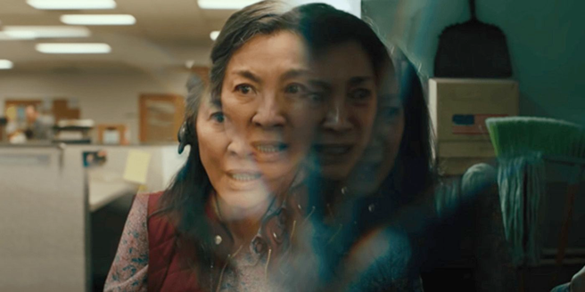

Notes:
set up everything everywhere...main character with undiagnosed adhd. literally manifests by living in multiple realities

Slide 14
clip from Everything Everywhere All At Once

Slide 15
You have so many goals you never finished, dreams you never followed. You’re living your worst you.
— Waymond Wang
Notes:
feel like a failure. struggle to do what I want

Slide 16
ADHD is not a character flaw.
Notes:
If you are an employer, friend, coworker of someone with ADHD, know that it's not a character flaw. Not a lack of caring, motivation, effort

Slide 17
Toxic Productivity

Slide 18
Most self-help and productivity content is designed for neurotypical brains
Notes:
General advice focuses on things like motivation, planning, rewards. All things ADHDers struggle with.

Slide 19
clip of "The Hustle"

Slide 20
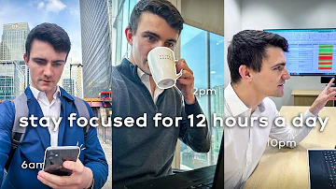



Notes:
trend in productivity culture, gurus, etc. perfect routine, the best apps. desire to optimize every little thing. What good do the little things do if you don't have the big ones down? If I'm not sleeping, exercising, etc.

Slide 21
You
Notes:
What can we do with this? Tools and tactics I've tried with varying degrees of success.

Slide 22
Deadlines

Slide 23
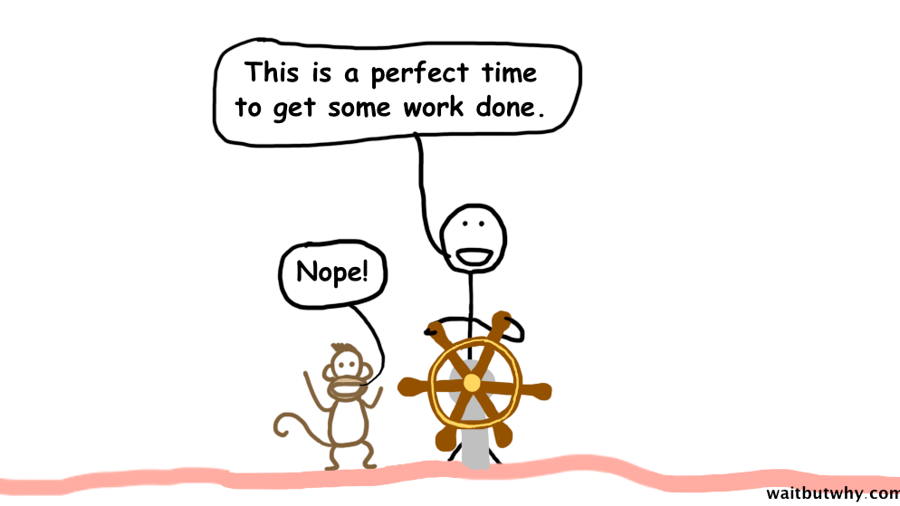
Notes:
Instant gratification monkey

Slide 24
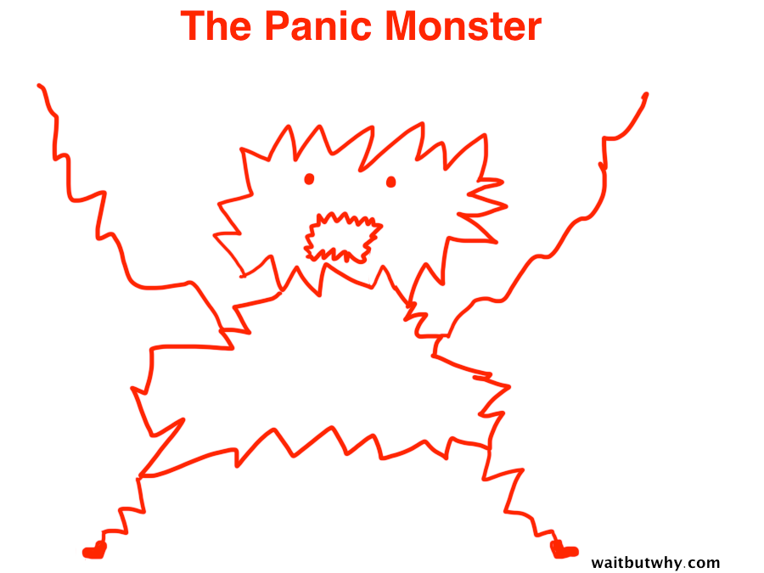
Notes:
Solution? Panic monster.

Slide 25
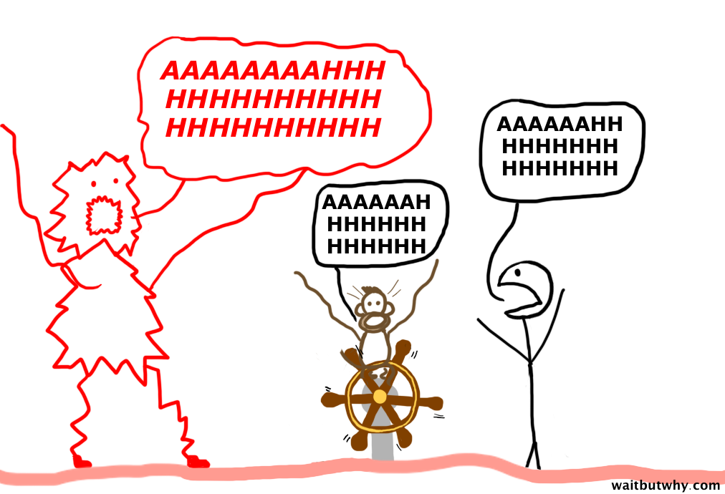
Notes:
Scares the hell out of the monkey (and you). Talk to your boss, take advantage of Agile sprints.

Slide 26
Novelty
Notes:
things that are new, unknown, challenging.</p>
<p>Want to know how to get me to complete a 500-point checklist that takes 200 hours?

Slide 27
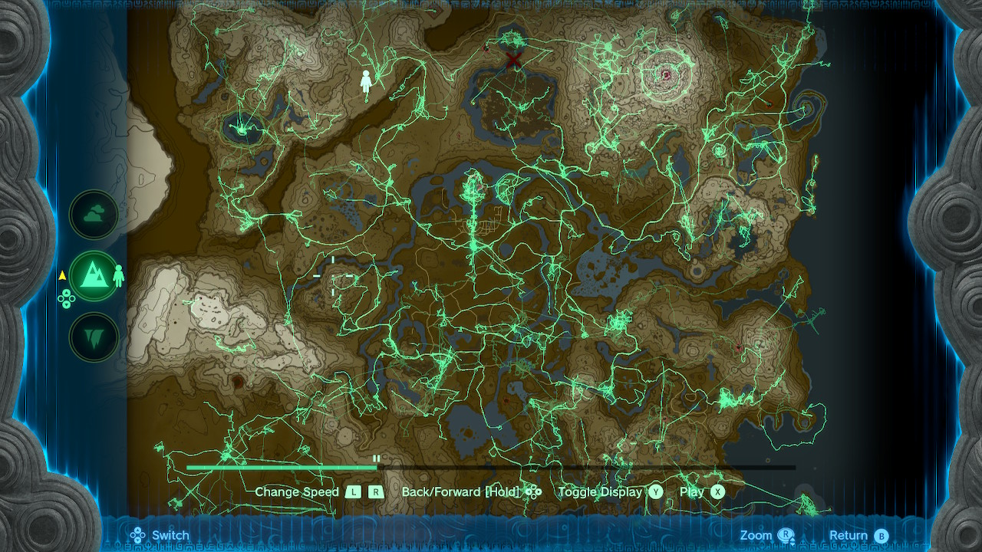
Notes:
Hero's Path in Zelda. developers intentionally try to distract. keep it interesting

Slide 28
Interests
Notes:
just the things I love. hobbies, like working on Plex, deep diving Lord of the Rings YouTube, Nerd of the Rings

Slide 29
Brain Dumps
There’s no real way to achieve the kind of relaxed control I’m promising if you keep things only in your head.
— David Allen, Getting Things Done
Notes:
<ul>
<li>taken from GTD</li>
<li>using an inbox</li>
<li>get things out of your head</li>
</ul>

Slide 30
Growth Mindset
To be in this mindset of "I'm not there yet, but the striving itself is the end goal."
— Andrew Huberman
Notes:
some days it's about doing anything at all

Slide 31
clip from Everything Everywhere All At Once

Slide 32
But you, here, you’re capable of anything because you’re so bad at everything.
— Waymond Wang
Notes:
<ul>
<li>this is a hard line for me to parse, to put into words</li>
<li>I'll let you noodle on it</li>
</ul>

Slide 33
Resources
ADHD 2.0
ADHD Jesse
Struggle Care
Notes:
KC Davis, How to Keep House While Drowning

Slide 34
Sources
"ADHD & How Anyone Can Improve Their Focus" Huberman Lab Podcast
"Getting Things Done" David Allen
"The Hustle" KRAZAM
"Why Procrastinators Procrastinate" Wait But Why

Slide 35

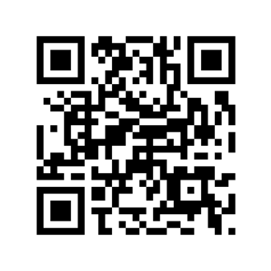
ᕕ( ᐛ )ᕗ Free RAM!
saterdalen.me/mwd

