Slide 1
Building a Backdoor
Strategies for Bypassing Validation Rules, Flows, and Triggers
Notes:
What makes this backdoor different than the backdoor used by Sam and Frodo to sneak into Mordor, in order to destroy the one ring, while being led by Gollum, who was secretly leading them into the lair of Shelob the spider, in order for her to kill Sam and Frodo so Gollum could take the one ring for himself, is that my backdoors have less bugs in them. </p> <p>Alternatively this session is called:

Slide 2
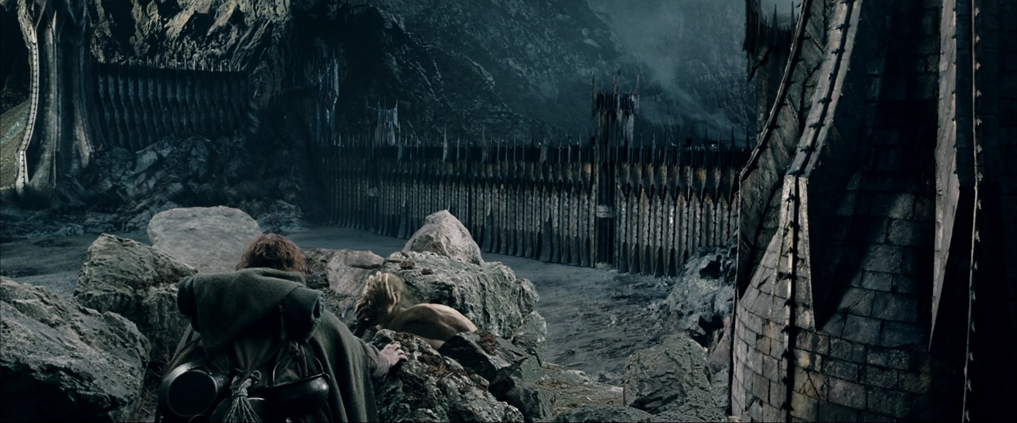
Slipping Past the Black Gate
The tunnel to Cirith Ungol
Notes:
On LinkedIn I promised LotR references during this talk. I don't know why I did that. So, here we go.

Slide 3
clip of Gollum

Slide 4
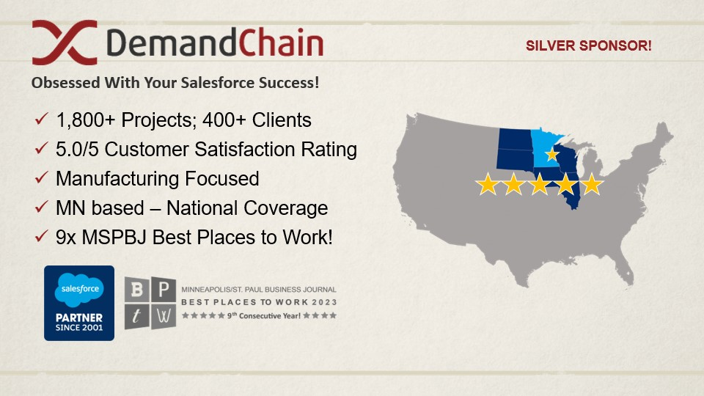

Slide 5
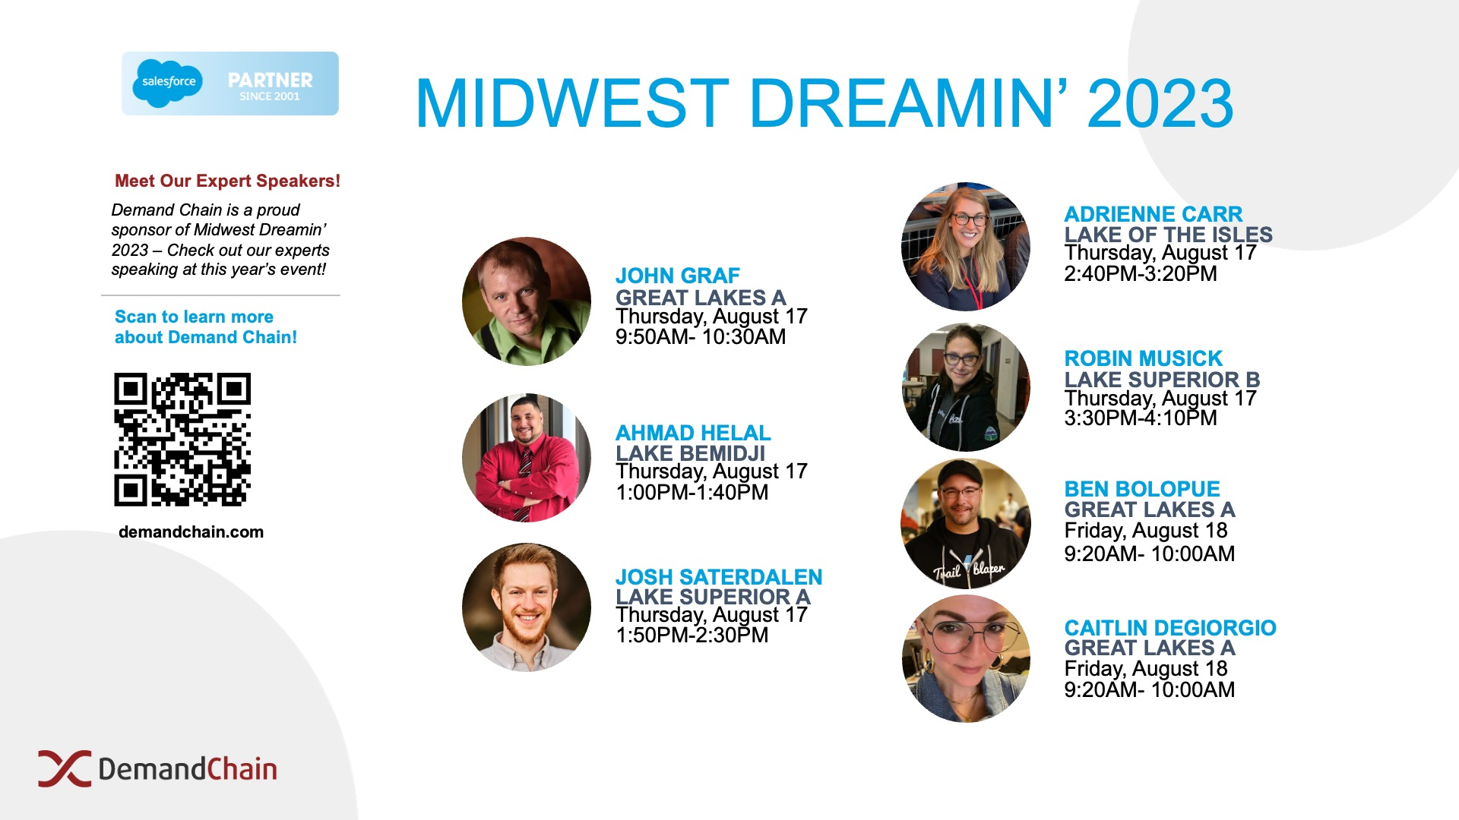

Slide 6
Disclaimer
I don't know what I'm talking about.
Notes:
I believe that we're all just making it up as we go along. no one has learned it all, we all have something to learn from others.

Slide 7
What am I actually talking about
Notes:
Validation Rules, record-triggered Flows, and Apex Triggers are essential tools for maintaining data cleanliness and automating business processes. While great for our users, these tools can get in the way of data loads, integrations, and record maintenance.

Slide 8
- bypass things per user/profile
- bypass things per record
- bypass automations with automations

Slide 9
Custom Settings Can Sneak Past Anything
Tricksy little Hobbitses
Notes:
Bypassing on a user/profile basis </p> <p><mark>ask for show of hands on data loads</mark>

Slide 10
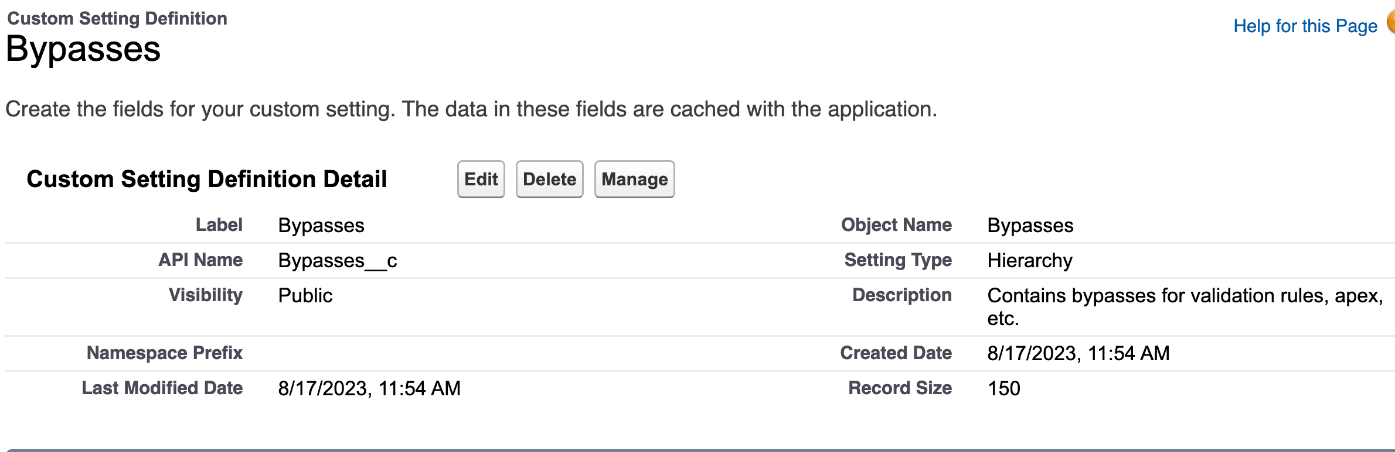

Slide 11
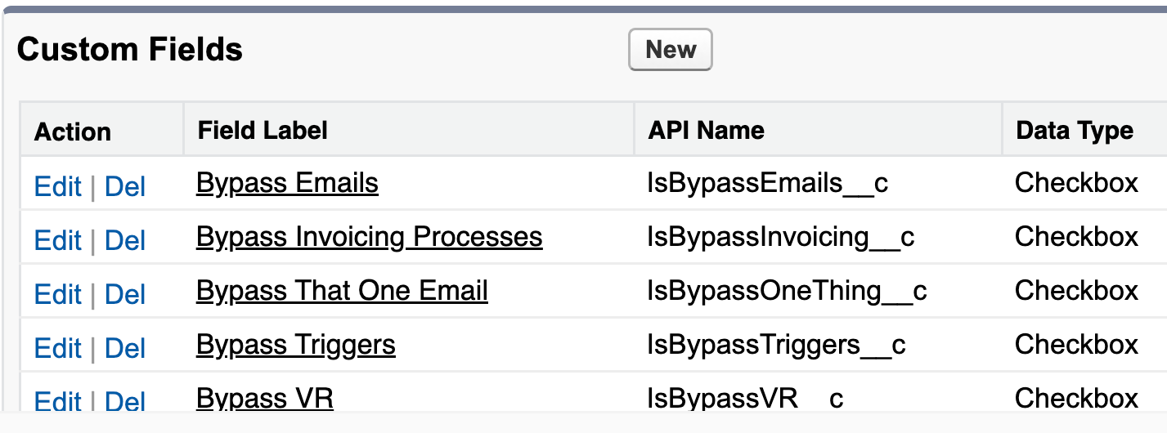
Notes:
create custom setting with a type of hierarchy. add checkboxes for each thing you want to bypass. &quot;all account triggers&quot; or &quot;sales opportunity stage automation&quot;

Slide 12
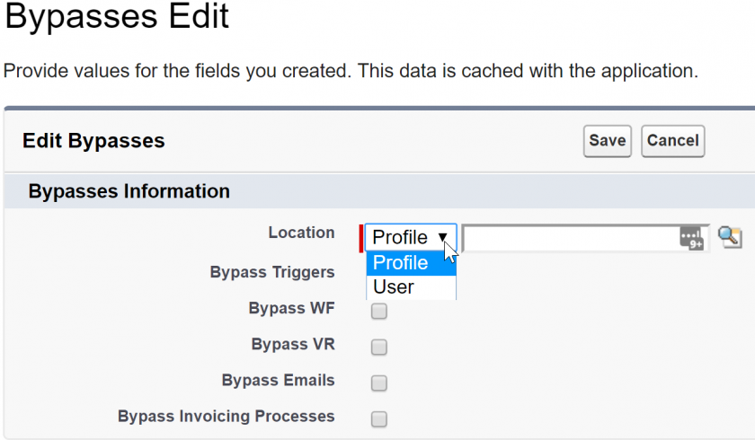
Notes:
add users or profiles. system admins, data loaders, integration users

Slide 13
Validation Rule Example
✅ Good
!$Setup.Bypasses__c.IsBypassVR__c && Name = "Frodo"

Slide 14
🚫 Bad
$Profile.id <> '00eo0000000KXdC' && SomeField__c = "There and Back Again"

Slide 15
🚫 Also Bad
$Profile.Name <> 'System Admin' && SomeField__c = "There and Back Again"

Slide 16
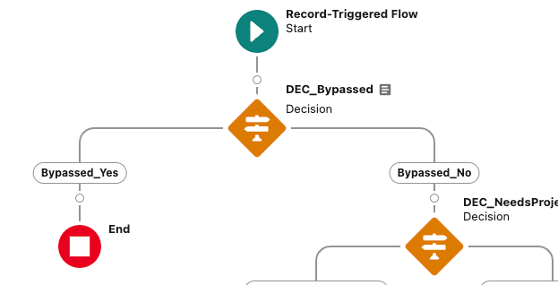
Flow Example
Notes:
Start flows with a check for this custom setting

Slide 17
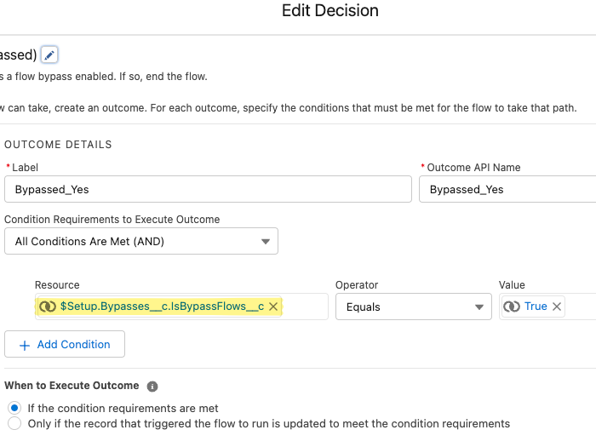

Slide 18
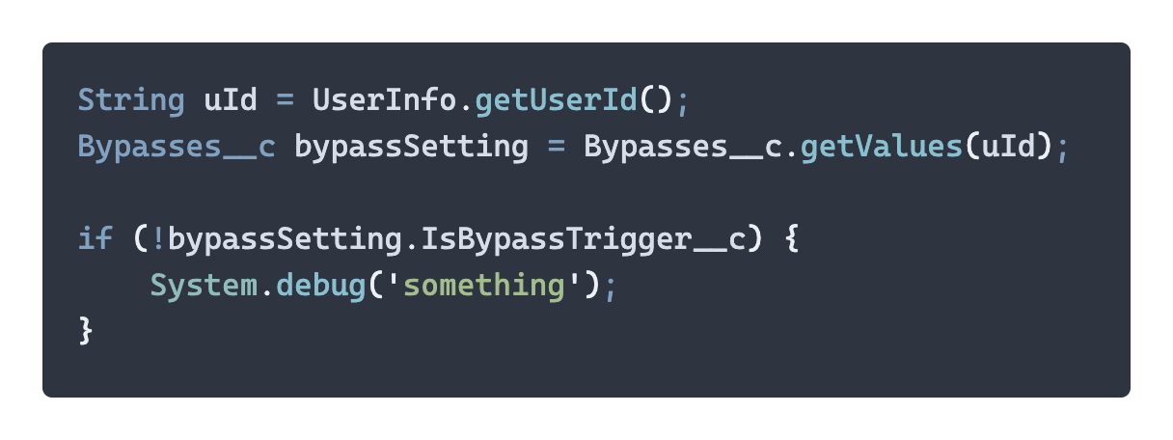
Apex Example
Notes:
I have a recording of someone using a bypass

Slide 19
clip of Bilbo
Notes:
actual footage of Bilbo Baggins bypassing your triggers

Slide 20
Custom Permission
Use those fancy Permission Sets
Notes:
can also use custom perms for this. reference in VR

Slide 21
Per Record Validation Bypass
We are Gandalf the White
Notes:
Where we get into ignoring validation rules on-demand. </p> <p>time stamp on records. check within VR. add to automation. add to integration

Slide 22
clip of Gandalf and Theoden
Notes:
We'll say that Theoden is the validation rule in this scenario, telling users they have no power.

Slide 23
AutomationBypassDateTime__c
- date/time field
IsAutomationBypassed__c
- formula, checkbox
AutomationBypassDateTime__c > NOW() – 0.00005787037 /*Five Seconds*/
Notes:
lots of variations of this floating around. credit Jen Lee for this specific setup

Slide 24
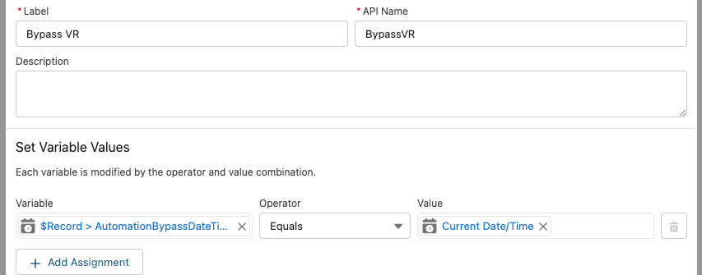
Flow Example

Slide 25
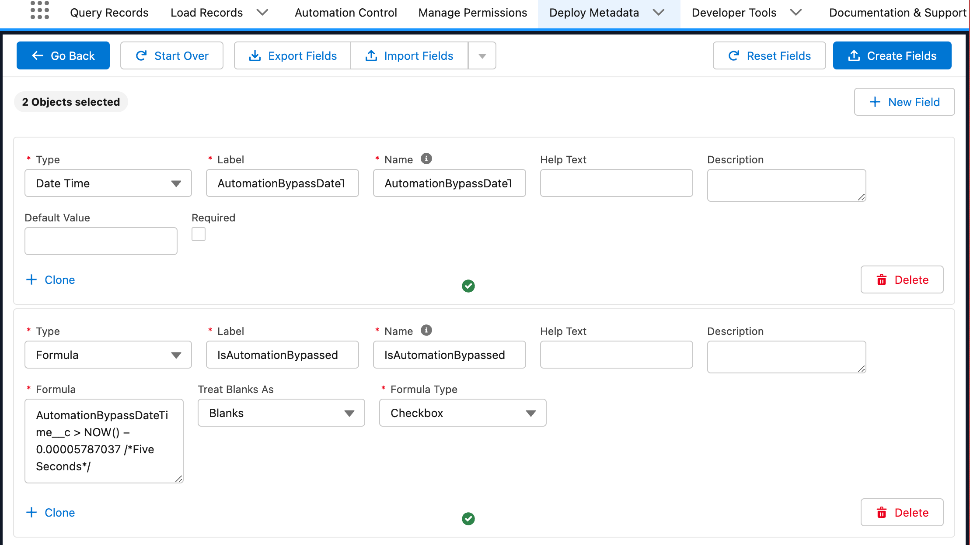
Notes:
pitch jetstream because it's amazing

Slide 26
Quick detour through the Mines
Naming Conventions
Notes:
naming things well is useful when building these patterns. being consistent helps you and whoever comes after you

Slide 27
Naming Validation Rules
Rule name: AcctVR01_LockAccountName
Error
Sales Reps are not allowed to change an account's name [AcctVR01]
Notes:
Use codes like this to keep track of your rules when you, users, and automations get VR errors

Slide 28
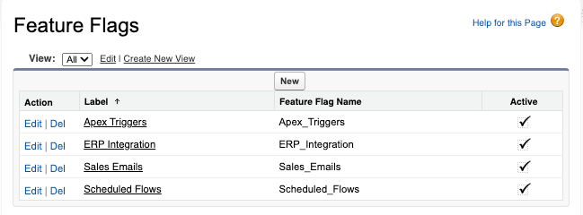
Feature Flags
Notes:
Feature flag custom metadata can be used to enable/disable specific business processes system-wide. Could be used as a toggle for all Apex triggers, all flows, etc. Disable all automated Sales emails temporarily. </p> <p>Implement with custom settings, like above, to give a new feature you're working on to only certain users or profiles.

Slide 29
Triggers on Triggers
What's triggers, precious?
Notes:
bypassing other automations within trigger/flow transactions is hard. weird workarounds. could use the timestamp switch and check for that

Slide 30
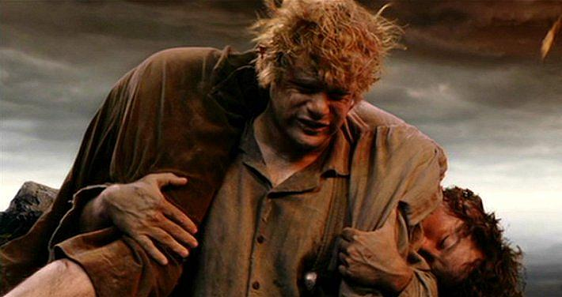
Trigger Frameworks
Come, Mr. Frodo. I can't carry it for you, but I can carry you! – Sam Gamgee
Notes:
analogies are really breaking apart here. don't reinvent the wheel. let others carry the load

Slide 31
Trigger Actions Framework
Notes:
One that I really like is the trigger actions framework, by Mitch Spano.

Slide 32
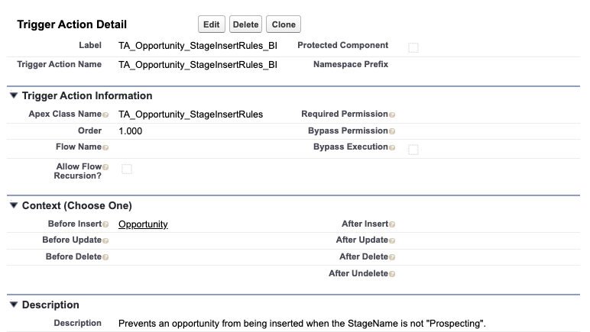

Slide 33
Bypass per Transaction
bypass all actions on an sObject as well as specific Apex or Flow actions for the remainder of the transaction using Apex or Flow.

Slide 34
Bypass from Apex
Use the static bypass(String name) method in the TriggerBase, MetadataTriggerHandler, or TriggerActionFlow classes.

Slide 35
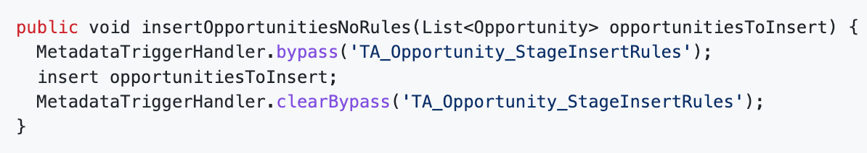

Slide 36
Bypass from Flow
Use the TriggerActionFlowBypass.bypass invocable method. You can set the Bypass Type to Apex, Object, or Flow, then pass the API name of the sObject, class, or flow you would like to bypass into the Name field.

Slide 37
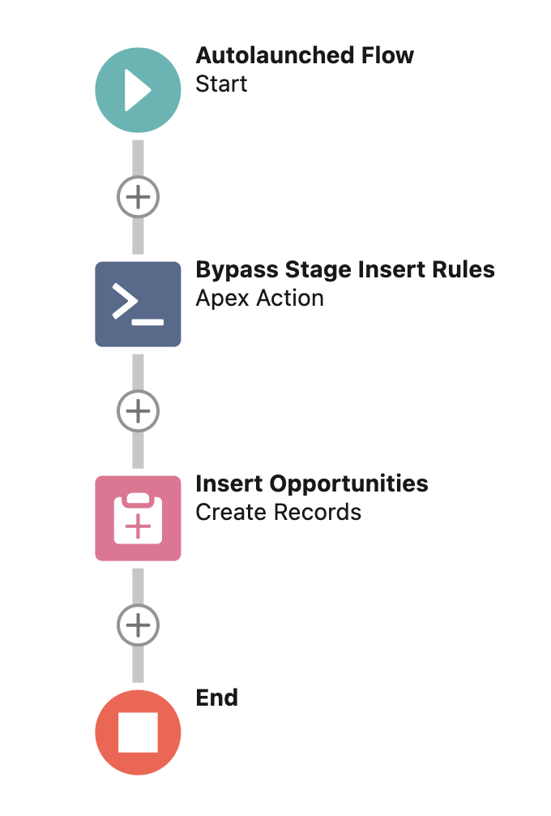
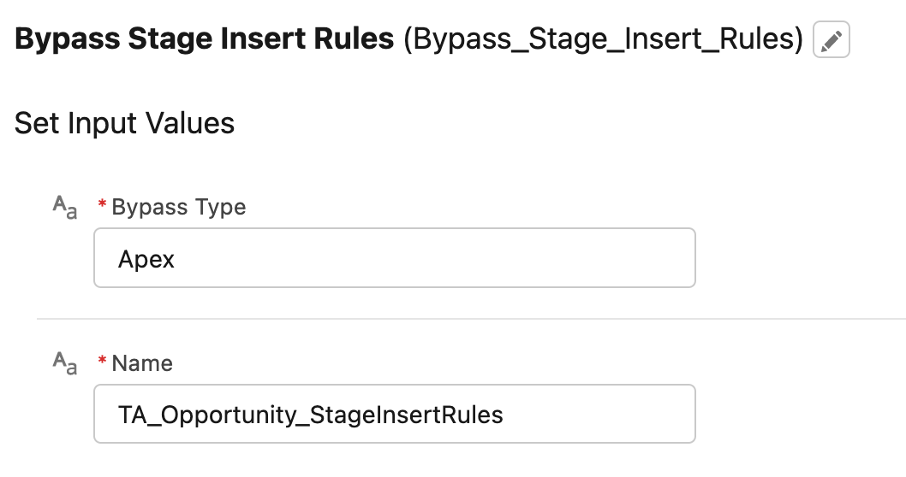

Slide 38
...and more!
Notes:
bypass globally, bypass per user, bypass based on custom permissions. pretty robust tool when you have an advanced use case

Slide 39
Resources
Jennifer Lee
Jetstream
SFXD Wiki
Trigger Actions Framework

Slide 40
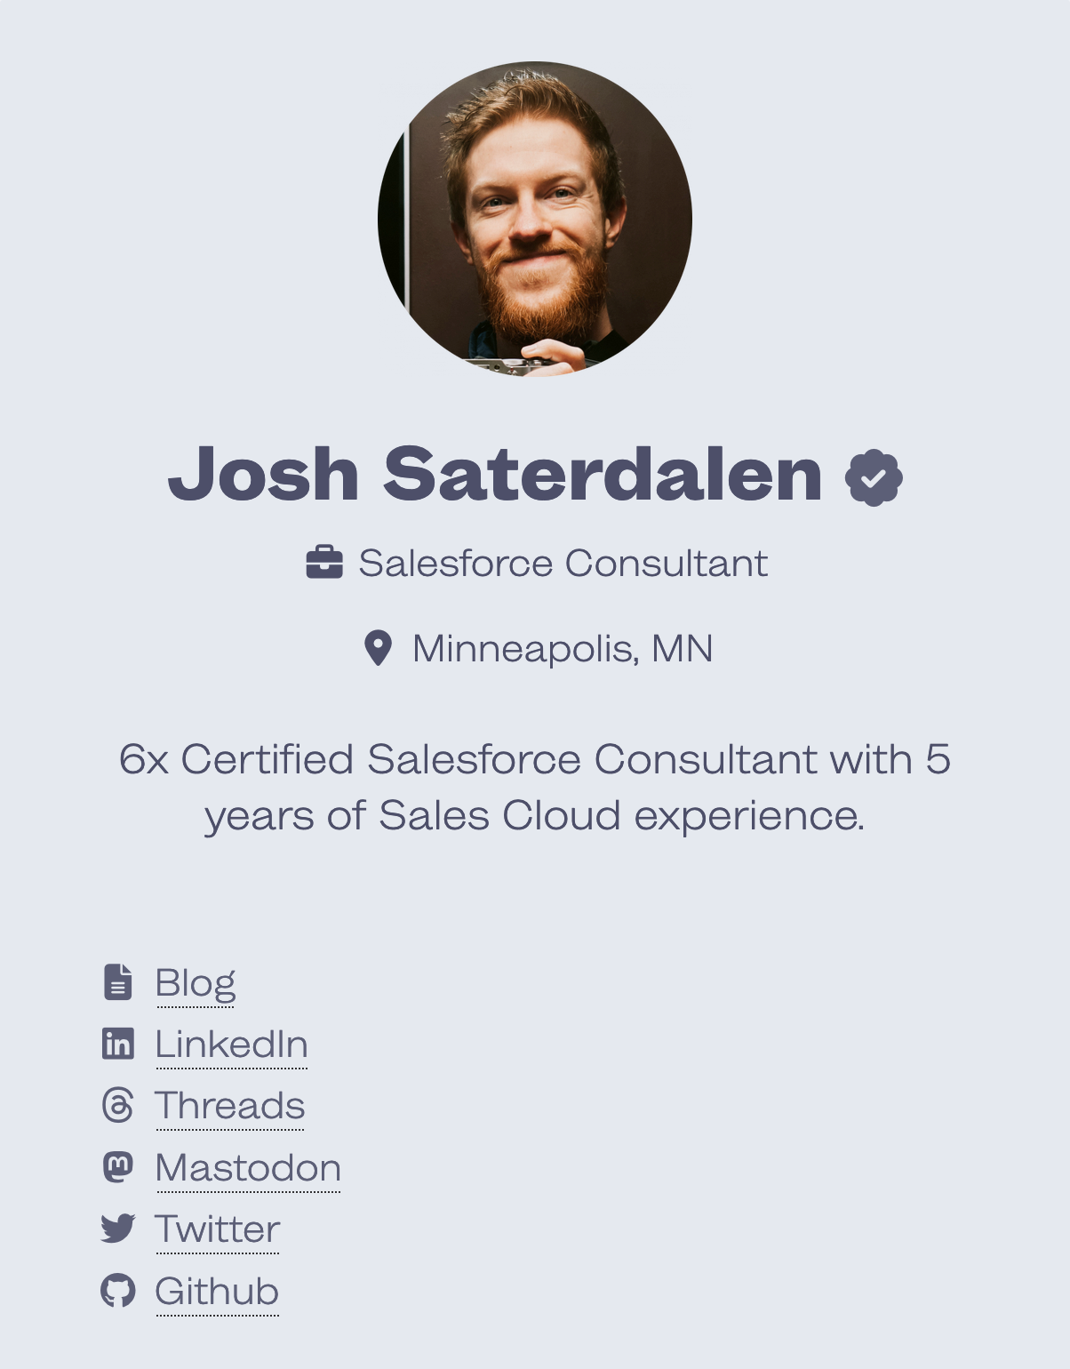
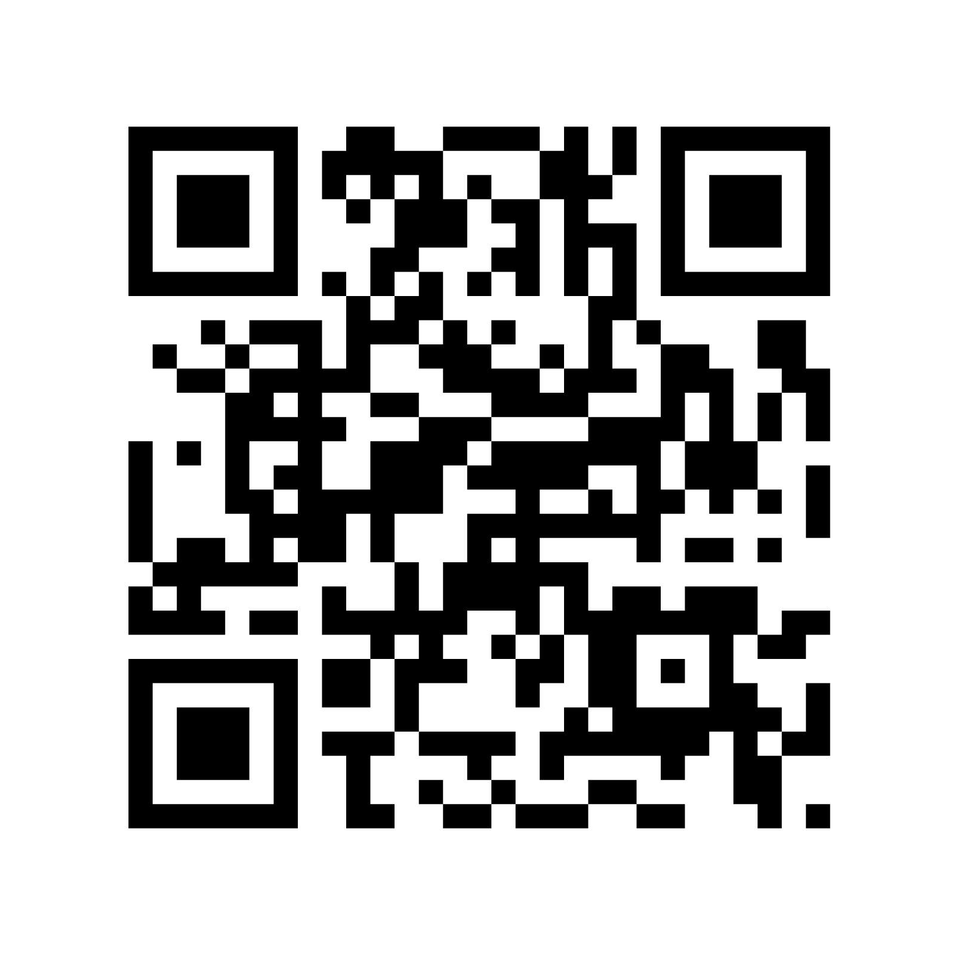
ᕕ( ᐛ )ᕗ Free RAM!
saterdalen.me/mwd

